Slide 2
Quiz 01.16 Function Design
Apprentice: Design a function called rocket-height, which takes in the current height of a rocket and produces the next height 3 pixels higher.
Practitioner: Design a function that takes in an index and a string and returns the 1String at the given index. Use the string-ith function in your definition.
Professional: Design a function that calculates the value of a new Metrocard. The function takes in the amount of money the customer wants to pay and returns the value of the card. There is a $1 fee for a new card. An 11% bonus is added when they spend $5.50 or higher

Slide 3
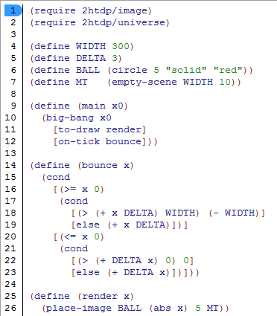
bounce
What will the program do?

Slide 4
keypress
Design a function that takes in a number and a string and returns a new world based on the key that is pressed. “r” should return 0, “m” should return the middle of the screen. Any other key should be ignored, i.e. just return the current state.

